Slide 1

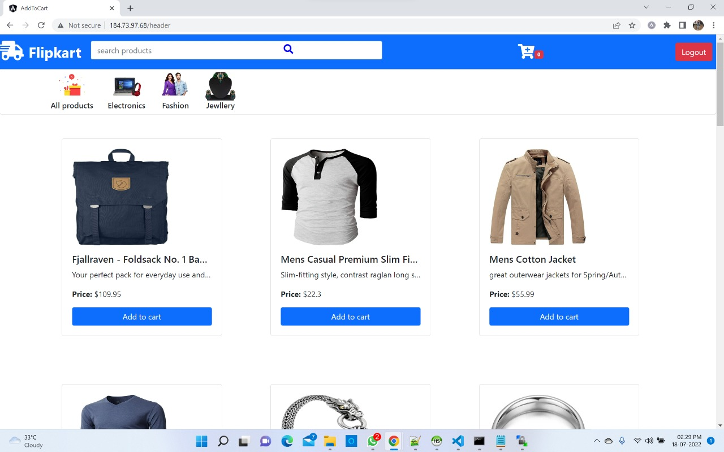
Shopping-cart
Team: Lokesh Gehlot
Mohd Shan
Om gurav
Ritik Chauhan
Under the guidance of : Mr. Ranjith Mor

Slide 2
Outline
Problem Statement
Objective
Microservices
Project Overview
Architecture
Application Flow
Technology and Tools Used
Conclusion

Slide 3

Problem Statement
This is an eCommerce website built for selling products online. In this project, we have mainly considered adding the products to the user cart and letting them decide the number of items to buy. The users can increase or decrease the number of items in the cart.

Slide 4
Objective
Our objective is to provide best user experience to user so that user can buy products online without stepping outside.

Slide 5
Microservices
Login API
Sign-up API
Product API

Slide 6
Project Overview

Slide 7
Project Overview
Login API
Sign-up
Login
index
Register
Search
SQL
DB
SQL DB
External API

Slide 8
Onboarding Architecture

Slide 9
Architecture
Login API
SQL Db
Login
GET request
Sign-up API
Register
SQL Db
POST request
Front End
Angular
GET
External API
Product API
GET
Search Products
External API
GET
GET

Slide 10
Project Flow

Slide 11
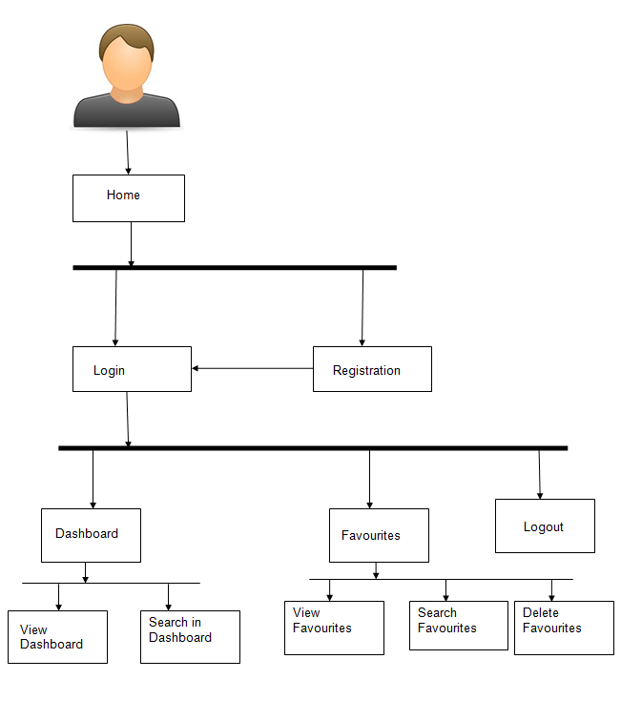
Project Flow
Home
Login
Register
Home page
Recommends
Add to cart
General items
Category– wise items
Edit the cart
Delete the Items
Search Books

Slide 12
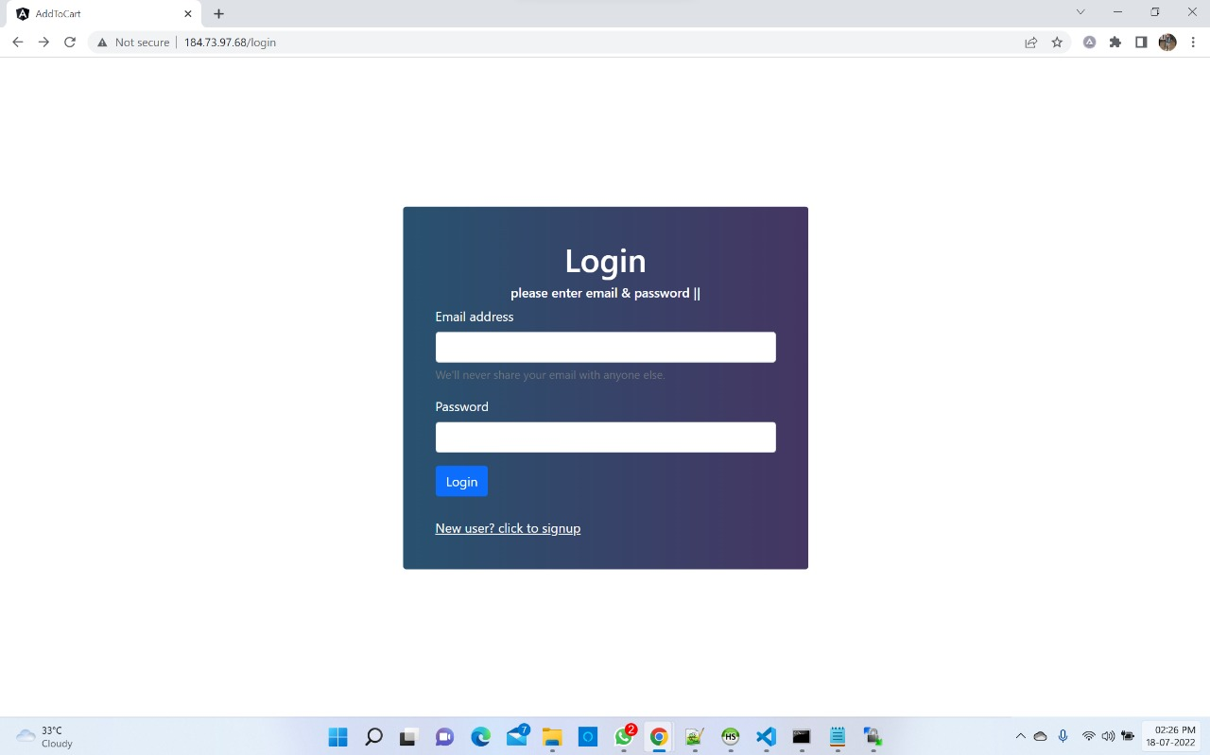
Login page

Slide 13
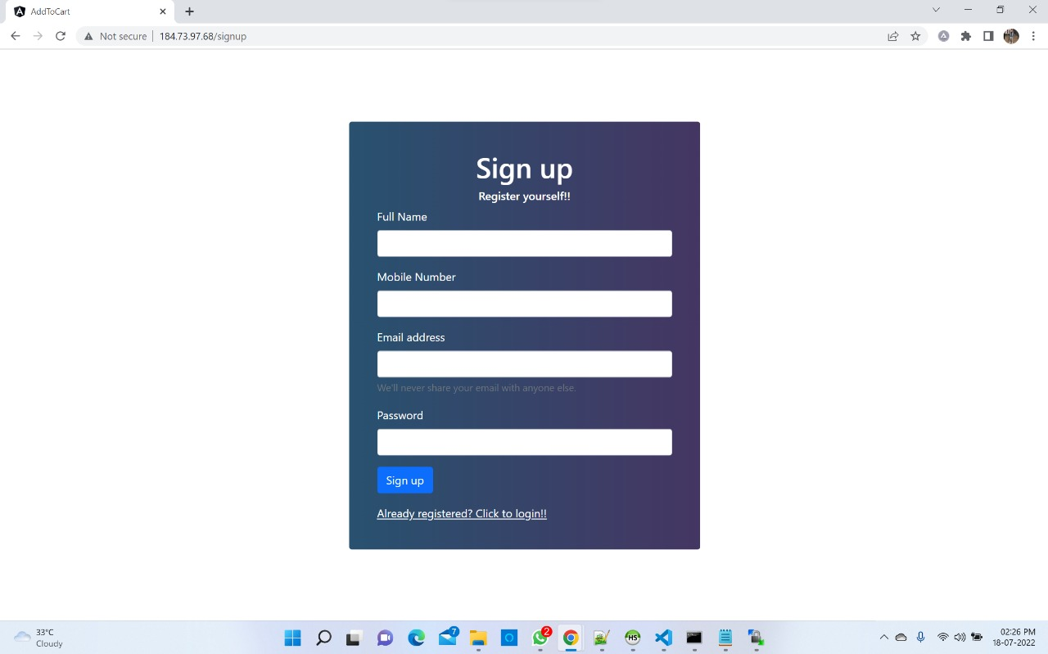
Sign-up page

Slide 14
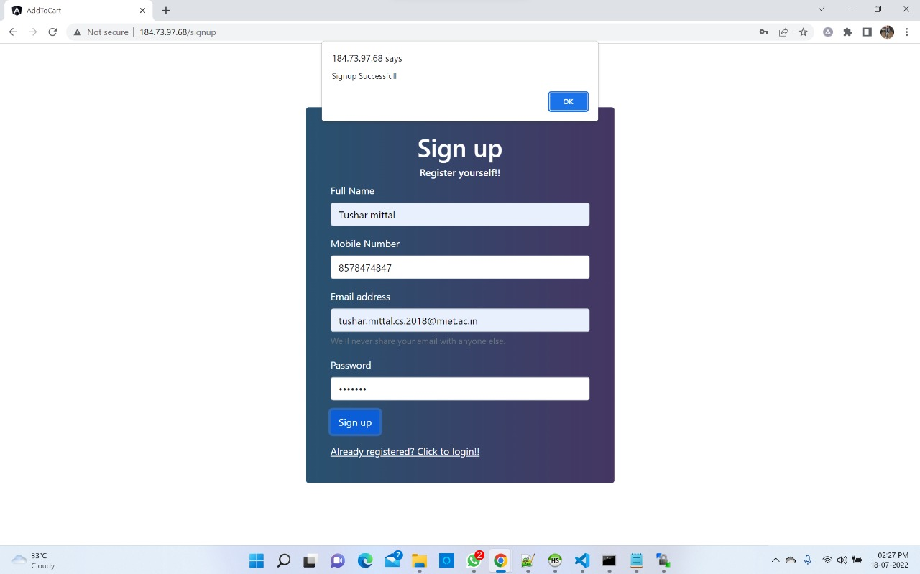
Sign-up details page

Slide 15
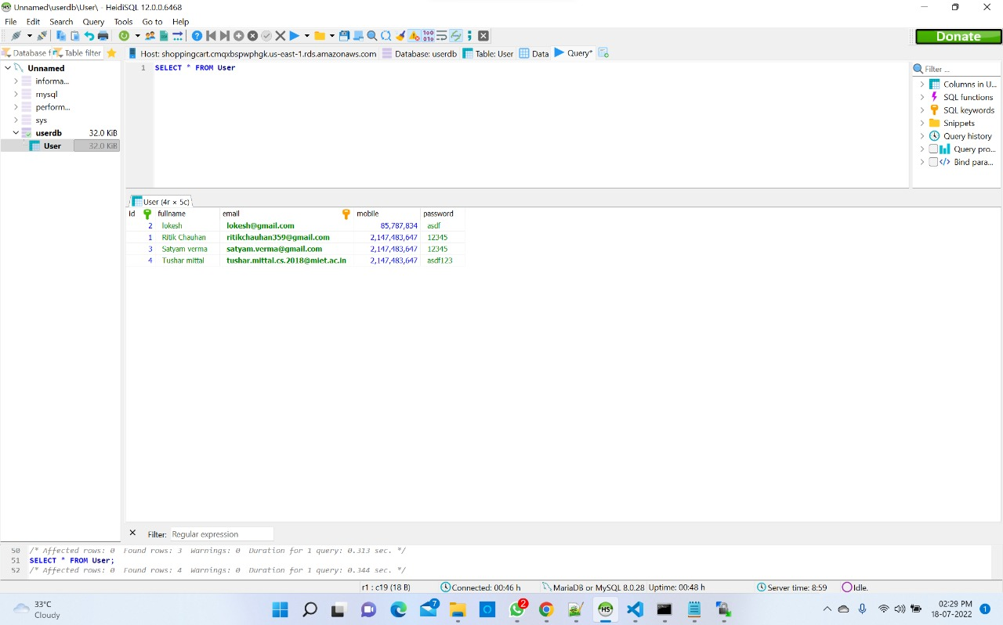
Updated Database

Slide 16
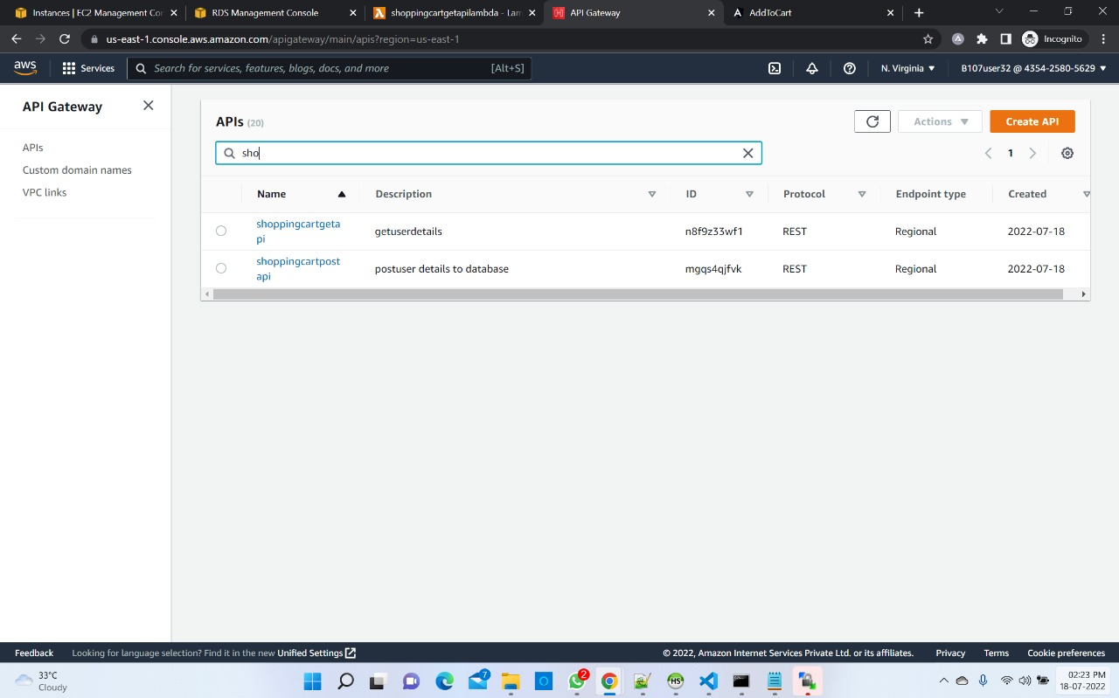
GET/POST API (for user)

Slide 17
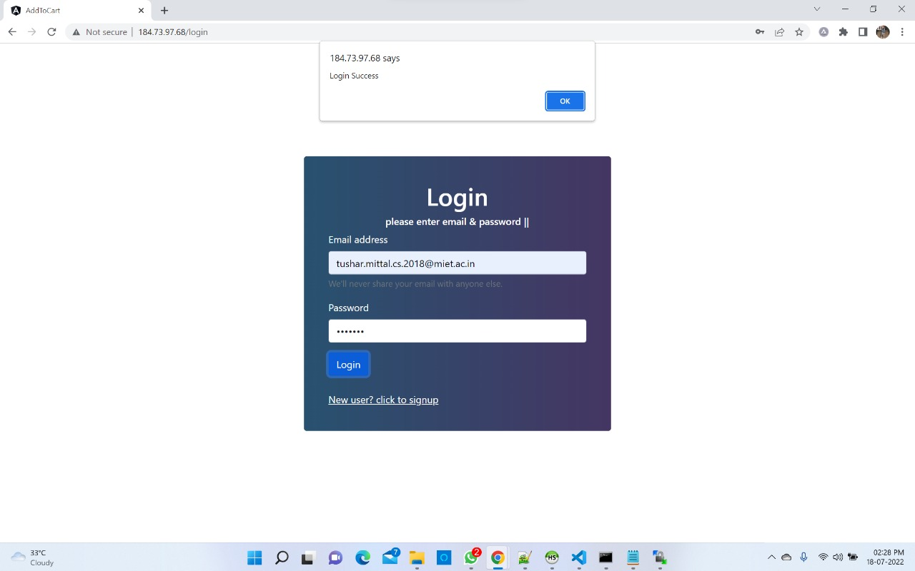
Login success page

Slide 18
Home page

Slide 19
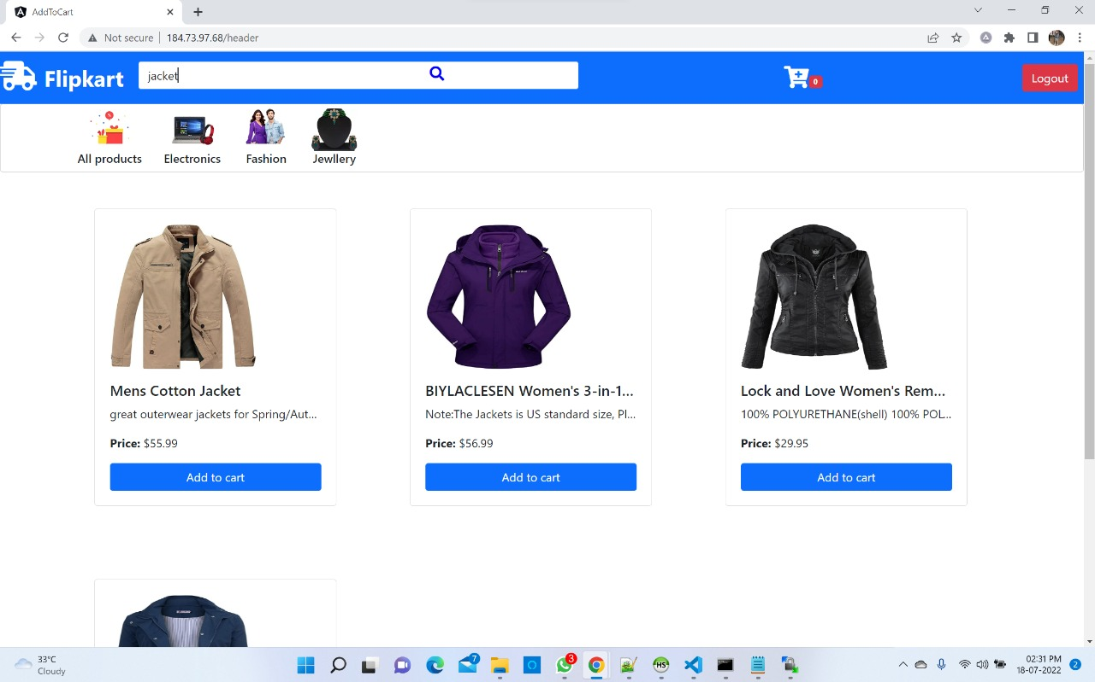
Search Functionality

Slide 20
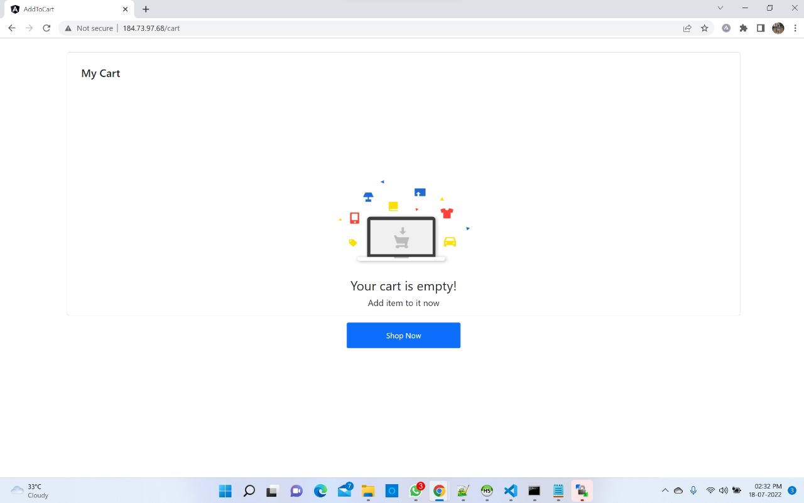
Empty cart

Slide 21
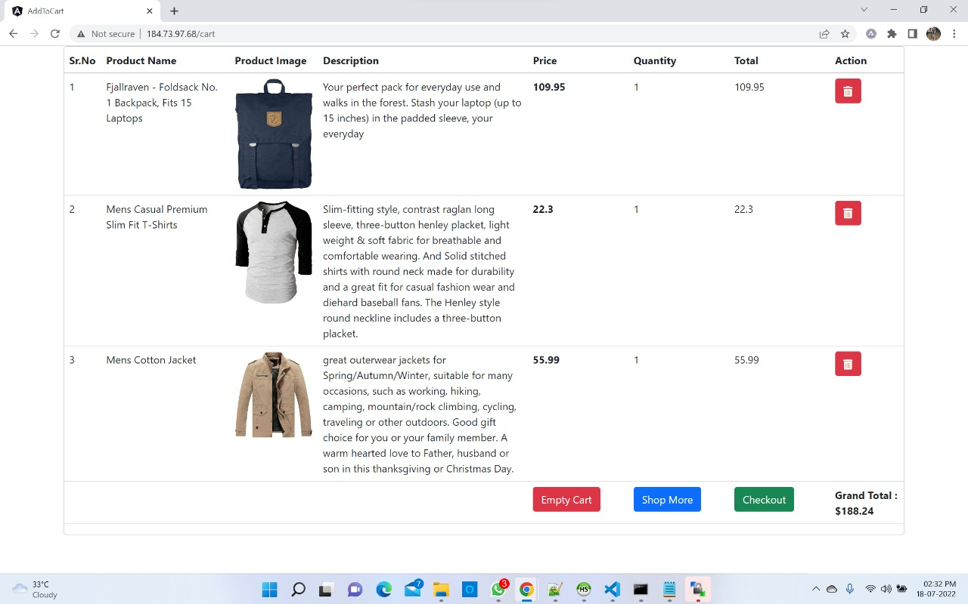
Cart - items

Slide 22






Technologies and Tools Used

Slide 23
Conclusion
It’s a web-based application project in which user can login and can see general category of items and can add particular items in his cart .
He can also edit and delete the cart items.

Slide 24
Thank You

